Slide 1

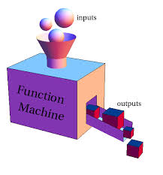
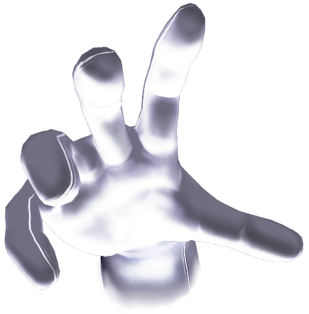
Functions and Logic Flow
Functions, Loops and Scope
SoftUni Team
Technical Trainers
Software University
http://softuni.bg

Slide 2
Table of Contents
JavaScript Functions
Syntax, Invocation, Return
For and While Loops
Scope
Local variables
Global variables

Slide 3
Have a Question?
sli.do #JS-CORE

Slide 4
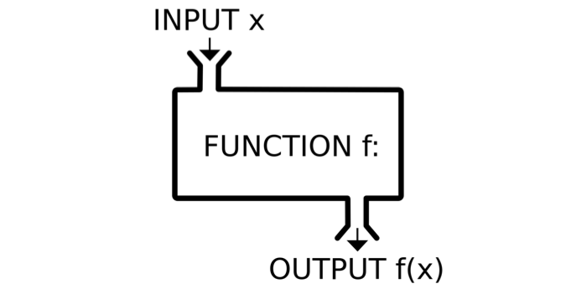
JavaScript Functions
Syntax, Invocation, Return, Functions as values

Slide 5
Functions in JS
Why Functions?
You can reuse code, define once, use many times.
Function = block of code
Can take parameters and return result
Function name: use camelCase
Function parameters: use camelCase
function printStars(count) {
console.log("*".repeat(count));
}
The { stays at the same line
Invoke the function
printStars(10);

Slide 6
Functions in JS (2)
function sum (a, b) {
console.log(a + b);
}
sum (5, 6); // 11
Invoke the function with different parameters value
function sum (a, b = 3) {
console.log(a + b);
}
sum (11); // 14
Default function parameters
function sum (a, b) {
return a + b;
}
let c = sum (5.8, 3);
console.log (c); // 8.8
Return ends function execution

Slide 7
Function Declaration, Expression, Arrow
function walk() {
console.log('walking');
}
walk(); // walking
Function Declaration
let solve = function walk() {
console.log('walking');
}
solve(); // walking
Function Expression
let solve = () => {
console.log('walking');
}
solve(); // walking
Arrow function

Slide 8
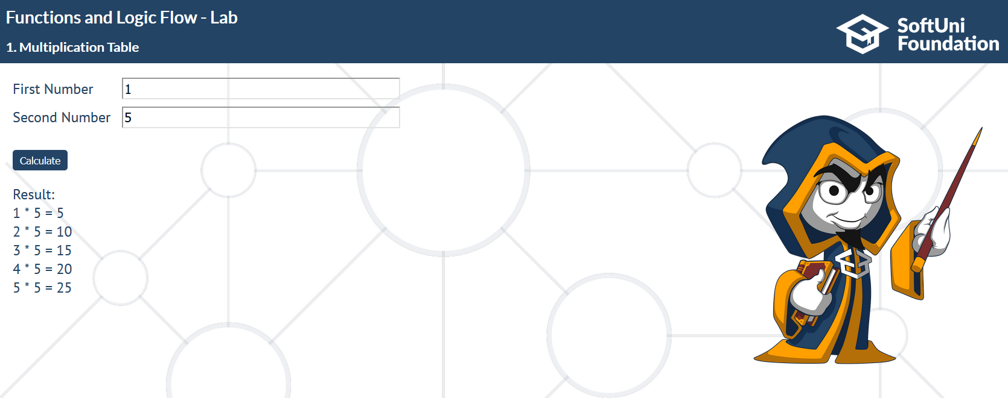
Problem: Multiplication Table
Write a JS function to create multiplication table based on 2 numbers, that you will receive. If the first number is greater, print "Try with other numbers."

Slide 9
Problem: Multiplication Table (2)
function multiplicationTable () {
let numberToBeMultiplied = parseInt(document.getElementById("num1").value);
let multiplier = parseInt(document.getElementById("num2").value);
let divResult = document.getElementById('result');
function findWrongInput(numberToBeMultiplied, multiplier) {
if (numberToBeMultiplied > multiplier) {
document.getElementById("result").innerHTML = "Try with other numbers.";
}
}
// Continues on the next slide

Slide 10
Problem: Multiplication Table (2)
function printTable(numberToBeMultiplied, multiplier) {
for (let i = numberToBeMultiplied; i <= multiplier; i++) {
let result = multiplier * i;
let p = document.createElement('p');
p.textContent = `${i} * ${multiplier} = ${result}`;
divResult.appendChild(p);
}
}
divResult.textContent = '';
findWrongInput(numberToBeMultiplied, multiplier);
printTable(numberToBeMultiplied, multiplier);
}
multiplicationTable(8, 3)
Try with other numbers.

Slide 11
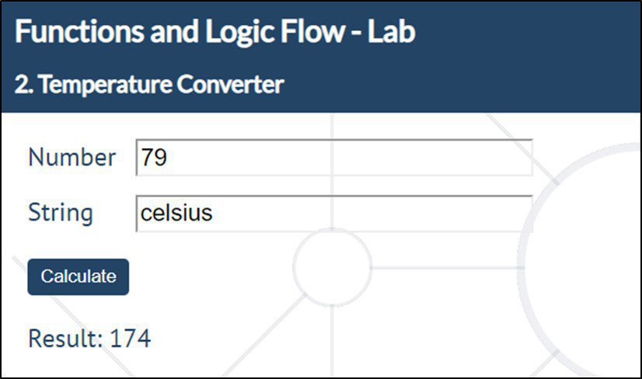
Problem: Temperature Converter
Write a JS function to convert Fahrenheit to Celsius.
Check your solution here: https://judge.softuni.bg/Contests/Practice/Index/1449#1

Slide 12
Problem: Temperature Converter (2)
function temperatureConverter() {
let degrees = parseInt(document.getElementById("num1").value);
let type = document.getElementById("type").value;
let result = '';
let convertedTemperature = 0;
let correctType = false;
function convert(degrees, type) {
if (type.toLowerCase() === "fahrenheit") {
convertedTemperature = (((degrees - 32) * 5) / 9);
correctType = true;
} else if (type.toLowerCase() === "celsius") {
convertedTemperature = ((degrees * 9) / 5) + 32;
correctType = true;
}
}
// Continues on the next slide

Slide 13
Problem: Temperature Converter (3)
function print(degrees, type) {
if (correctType) {
result = Math.round(convertedTemperature);
} else {
result = "Error!";
}
} convert(degrees, type);
print(degrees, type);
document.getElementById("result").innerHTML = result;
}
temperatureConverter(85, "fahrenheit");
29

Slide 14
Function Invocation
The code inside a function is executed when the function is invoked with () operator
Invoke the function after declaration
function write(name) {
console.log(`I am ${name}`);
}
write('George'); // I am George
write('George'); // I am George
function write(name) {
console.log(`I am ${name}`);
}
Invoke the function before declaration

Slide 15
Function Invocation (2)
Anonymous self-invoking function
(function (count) {
for (let i = 1; i <= count; i++)
console.log('+'.repeat(i));
})(4);
+
++
+++
++++
This is called "closure" (a state is closed inside)
let f = (function () {
let x = 0;
return function() { console.log(++x); }
})(); f(); f(); f(); f();
1
2
3
4

Slide 16
Function Return
Return statement ends function execution
function getRectArea(width, height) {
if (width > 0 && height > 0) {
return width * height;
}
return 0;
}
console.log(getRectArea(3, 4)); // 12
console.log(getRectArea(-3, 4)); // 0
let result = function (a, b) {
return a % b;
};
console.log(result(10, 3)); // 1

Slide 17
Variables Holding Functions
In JS variables can hold functions as their values
let f = function(x) { return x * x; }
console.log(f(3)); // 9
console.log(f(5)); // 25
f = function(x) { return 2 * x; }
console.log(f(3)); // 6
console.log(f(5)); // 10
f = undefined;
console.log(f(3)); // TypeError: f is not a function(…)

Slide 18
Functions as Parameters
function repeatIt(count, func) {
for (let i = 1; i <= count; i++)
func(i);
}
let starsFunc = function(i) {
console.log("**".repeat(i))
};
repeatIt(3, starsFunc);
repeatIt(3, function(x) {
console.log(2 * x);
});
**
****
******
2
4
6

Slide 19
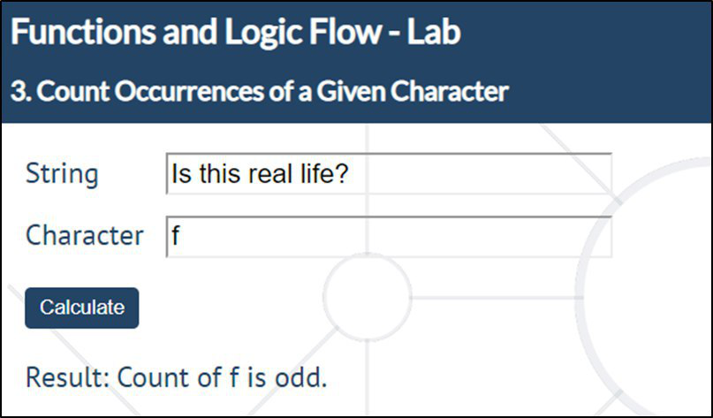
Problem: Count Occurrences of a Given Character
Write a JS function that finds occurrences of а character in а string
Takes 2 parameters – string and character
Finds the count of occurrences of the given char in the given string
Checks if the count is even / odd
countChars('Is this real life?', 'f');
Count of f is odd.

Slide 20
Problem: Count Occurrences of a Given Character
function countChars() {
let string = document.getElementById("string").value;
let char = document.getElementById("character").value;
let count = 0;
let result = '';
function findCharacterCount(string, char) {
for (let i = 0; i < string.length; i++) {
if(string[i] === char) {
count++;
}
}
}
Check your solution here: https://judge.softuni.bg/Contests/Practice/Index/1449#2

Slide 21
Problem: Count Occurrences of a Given Character
function evenOrOddCount(string, char) {
if (count % 2 === 0) {
result = `Count of ${char} is even.`;
} else {
result = `Count of ${char} is odd.`;
}
}
findCharacterCount(string, char);
evenOrOddCount(string, char);
document.getElementById("result").innerHTML = result;
}
Check your solution here: https://judge.softuni.bg/Contests/Practice/Index/1449#2

Slide 22
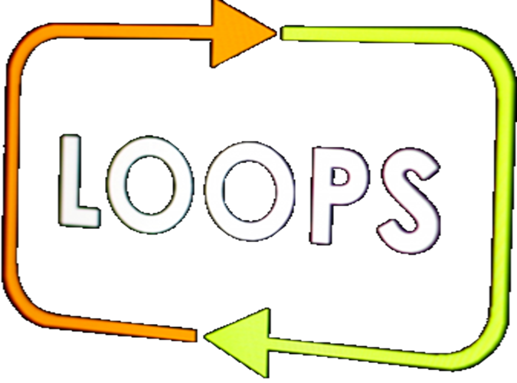
Loops in JS
For…in, For…of, While

Slide 23
Loops: for…in
The for / while loops work as in C++, C# and Java
For…in loop is used to iterate over the enumerable properties of objects
for…in loop iterates over the indexes
function solve(arr) {
for (const arrElement in arr) {
console.log(arrElement);
}
}
solve(['George', 5, null, 54]);
0
1
2
3

Slide 24
Loops: for…in
function solve(str) {
for (const character in str) {
console.log(str[character]);
}
}
solve('Hello');
H
e
l
l
o
function solve(obj) {
for (const objElement in obj) {
console.log(objElement);
}
}
solve({name: 'Peter', age: 32, town: 'Sofia'});
name
age
town

Slide 25
Loops: for…of
For…of loop is used to iterate over the iterable objects
function solve(arr) {
for (const arrElement of arr) {
console.log(arrElement);
}
}
solve(['George', 5, null, 54]);
George
5
null
54

Slide 26
Loops: for…in
function solve(str) {
for (const character of str) {
console.log(character);
}
}
solve('Hello');
H
e
l
l
o
function solve(obj) {
for (const objElement of obj) {
console.log(objElement);
}
}
solve({name: 'Peter', age: 32, town: 'Sofia'});
TypeError: obj is not iterable

Slide 27
Loop: while
The while loops through a block of code as long as a specified condition is true.
function count(num) {
while (num < 200) {
console.log(num *= 2);
}
}
count(5); // 10 20 40 80 160 320
function count(arr) {
while (arr.length>0) {
console.log(arr.length);
arr.length-=1;
}
}
count(['Peter', 45, 0, 58]); // 4 3 2 1

Slide 28
Problem: Unique Characters
Write a JS function that takes one string parameter and extract only the unique characters from the string except for whitespaces.
function extractUniqueChars() {
let uniqueChars = "";
let string = document.getElementById("string").value;
function findUniqueChars(string) {
for (let i = 0; i < string.length; i++) {
isCharWhiteSpace(i);
isCurrentCharUnique(i);
}
}
Check your solution here: https://judge.softuni.bg/Contests/Practice/Index/1449#3

Slide 29
Problem: Unique Characters (2)
function isCharWhiteSpace(i) {
if (string[i] === " ") {
uniqueChars += string[i];
}
}
function isCurrentCharUnique(i) {
if (uniqueChars.indexOf(string[i]) === -1) {
uniqueChars += string[i];
}
}
findUniqueChars(string);
document.getElementById("result").innerHTML = uniqueChars;
}

Slide 30
Scope
Local and global scope

Slide 31
Scope
Scope is the visibility of functions and variables in the different parts of your code during runtime.
Global Scope – Global variables can be accessed from anywhere in a JavaScript function
var name = 'Maria’; // code here can use name function myFunction() {
console.log(name); // code here can also use name }
myFunction(); // Maria
console.log(name); // Maria

Slide 32
Scope (2)
Function Scope – Local variables can only be accessed from inside the function where they are declared
Block Scope - Variables declared inside a block {} can not be accessed from outside the block.
function myFunction() { var name = 'Maria'; // only here code CAN use name }
console.log(name);
ReferenceError: name is not defined
{ let x = 2; } // x can NOT be used here

Slide 33
Automatically global
We can assign a value to a variable that has not been declared and it automatically become a Global variable
Invoke the function before declaration
myFunction();
console.log(name); // Maria
function myFunction() { name = 'Maria'; }

Slide 34
Automatically global (2)
Global variables are not created automatically in 'Strict Mode'
'use strict'
myFunction();
console.log(name); // ReferenceError: name is not defined
function myFunction() { name = 'Maria'; }

Slide 35
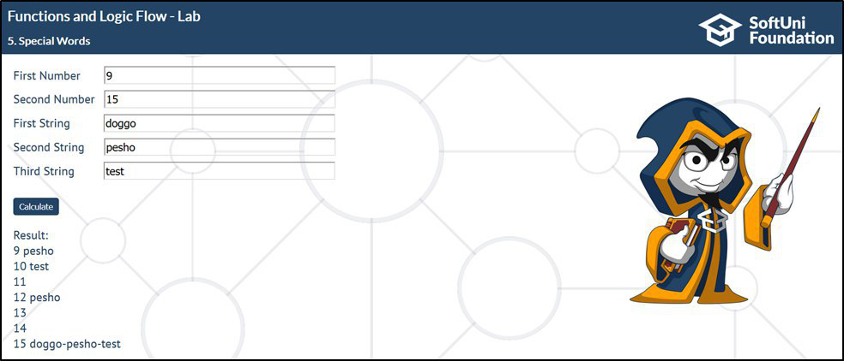
Problem: Special Words
Write a JS function that takes 5 parameters and Iterates from the first number to the second one.
For numbers which are multiples of both 3 and 5, print all 3 strings
For multiples only of 3, print the second string
For multiples only of 5, print the third string

Slide 36
Problem: Special Words (2)
function specialWords() {
let startNum = parseInt(document.getElementById("firstNumber").value);
let endNum = parseInt(document.getElementById("secondNumber").value);
let firstWord = document.getElementById("firstString").value;
let secondWord = document.getElementById("secondString").value;
let thirdWord = document.getElementById("thirdString").value;
let divResult = document.getElementById("result");
for (let i = startNum; i <= endNum; i++) {
checkCurrentNumber(i);
}
// Continues on the next slide
Check your solution here: https://judge.softuni.bg/Contests/Practice/Index/1449#4

Slide 37
Problem: Special Words (3)
function checkCurrentNumber(i) {
let p = document.createElement('p');
if (i % 3 === 0 && i % 5 === 0) {
p.textContent = `${i} ${firstWord}-${secondWord}-${thirdWord}`;
} else if (i % 3 === 0) {
p.textContent = `${i} ${secondWord}`;
} else if (i % 5 === 0) {
p.textContent = `${i} ${thirdWord}`;
} else {
p.textContent = i;
}
divResult.appendChild(p);
}
}

Slide 38


Live Exercises

Slide 39
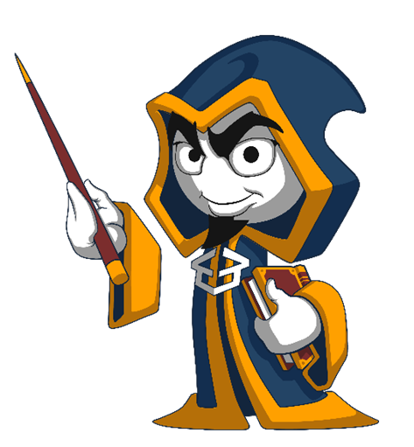
Summary
Arrow functions ≈ short function syntax
Function = named piece of code
Syntax, invocation, return
Loops – for…in, for…of, while
Local and global scope
function calcSum(a, b) {
let sum = a + b;
return sum;
}

Slide 40
https://softuni.bg/courses/javascript-fundamentals

Slide 41












SoftUni Diamond Partners

Slide 42




SoftUni Organizational Partners

Slide 43




Trainings @ Software University (SoftUni)
Software University – High-Quality Education and Employment Opportunities
softuni.bg
Software University Foundation
http://softuni.foundation/
Software University @ Facebook
facebook.com/SoftwareUniversity
Software University Forums
forum.softuni.bg

Slide 44

License
This course (slides, examples, demos, videos, homework, etc.) is licensed under the "Creative Commons Attribution-NonCommercial-ShareAlike 4.0 International" license

